Slide 1
AA AUTOMOBILE WORKSHOP
ALX SE PROGRAM
PROJECT PORTFOLIO
Member(s)
ABDULBASIT ABDULGANIYU
COHORT 12

Slide 2
Project Description
This is a web application named AA Automobile Workshop that is intended to provide the folowing functions and features respectively:
Functions
A full web application to display the services, blog and get feedback from users.
Features
A map to depict the exact use’s location
A login form using third party app such as google 0Auth
Team
This is a sole web application project written by:
Abdulbasit Abdulganiyu

Slide 3
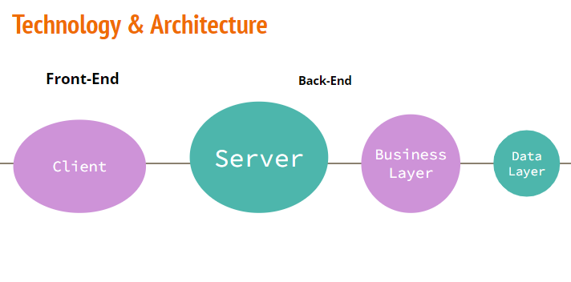
Technology Used

Slide 4
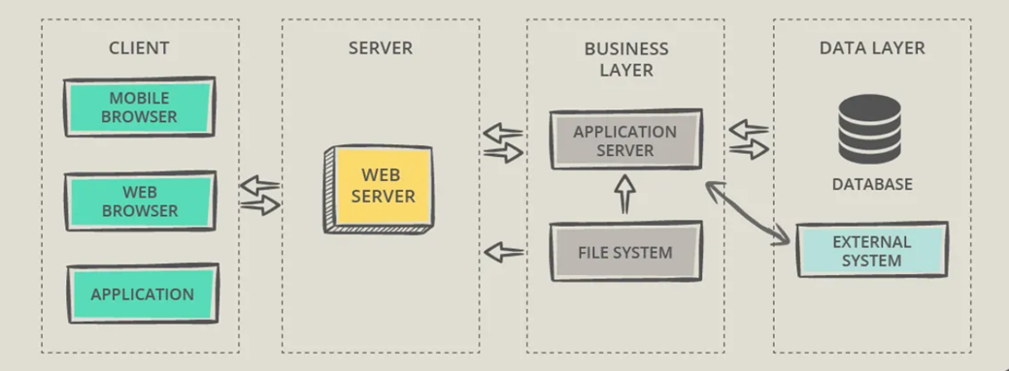
Block Diagram of Technology to be Adopted

Slide 5
Challenges
The challenges already identified include but not limited to the following:
A user needs to create a developer profile when using google map and login 0Auth to get and have valid accessible api.
A database need to be in place to keep record of using login details
Alot of backend routine for showing a nearby user whose maintenance and technical service is needed for peer to peer.

Slide 6
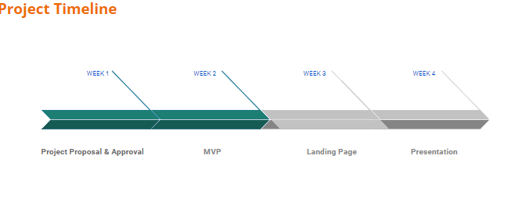
Schedule of Work

Slide 7
Learning Objectives
This project is intended to have the following objectives:
Frontend
The use of html, CSS and Javascript to create a dynamic web application
Backend
Use python flask or nodejs as the backend as the case maybe

